Slide 1
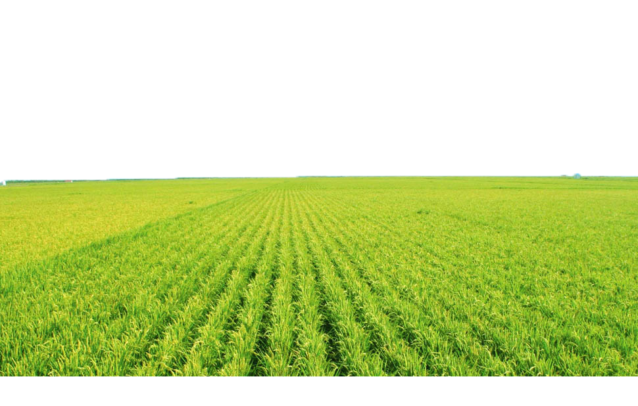
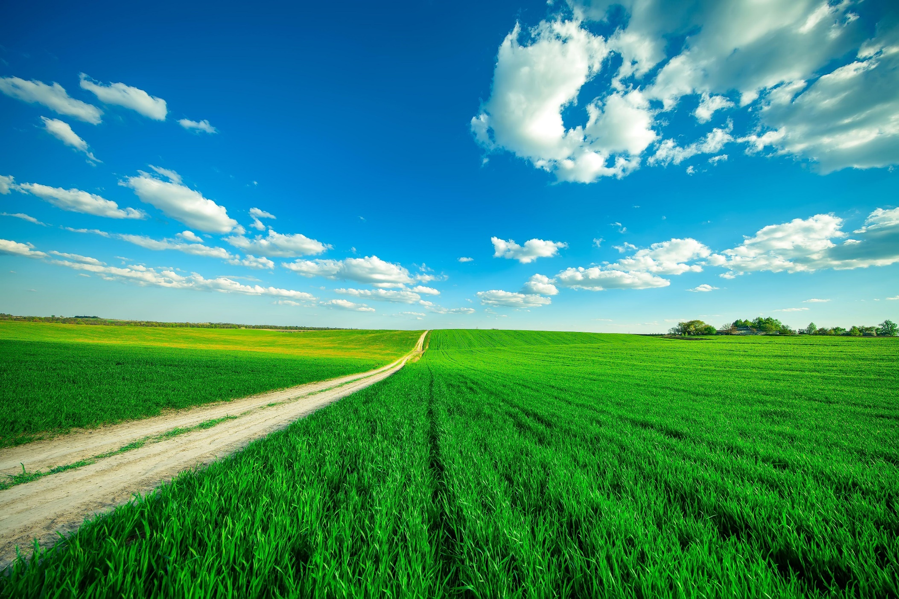



E-KETHA : ENRICHING RICE FARMER’S QUALITY OF LIFE THROUGH A MOBILE APPLICCATION
2022-81

Slide 2

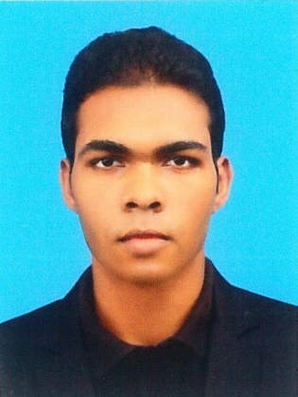


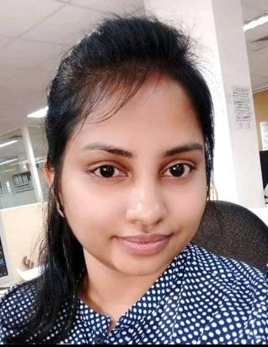

Meet The Team
Salika Madhushanka W.J
Group Leader
P.Y.D Jayasinghe Member 02
H.H.W.M.Binuka Sihan Paranagama Member 03
K.M.Umesh Ranthilina
Member 04
Ms. Amali Upeka Gunasinghe
Co-Supervisor
Mr. Adeepa Gunarathna Supervisor

Slide 3
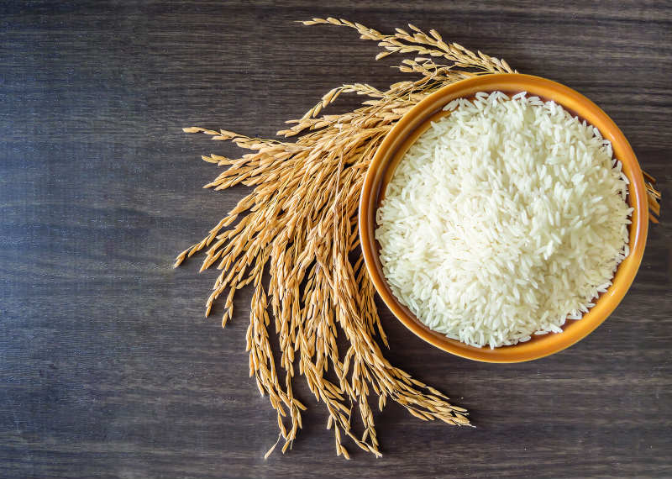
Introduction
Why rice is so important?
Great energy source
Improves the health of nervous system
Can reduce of cancer risks
Prevents obesity
Good source of protein [1]

Slide 4
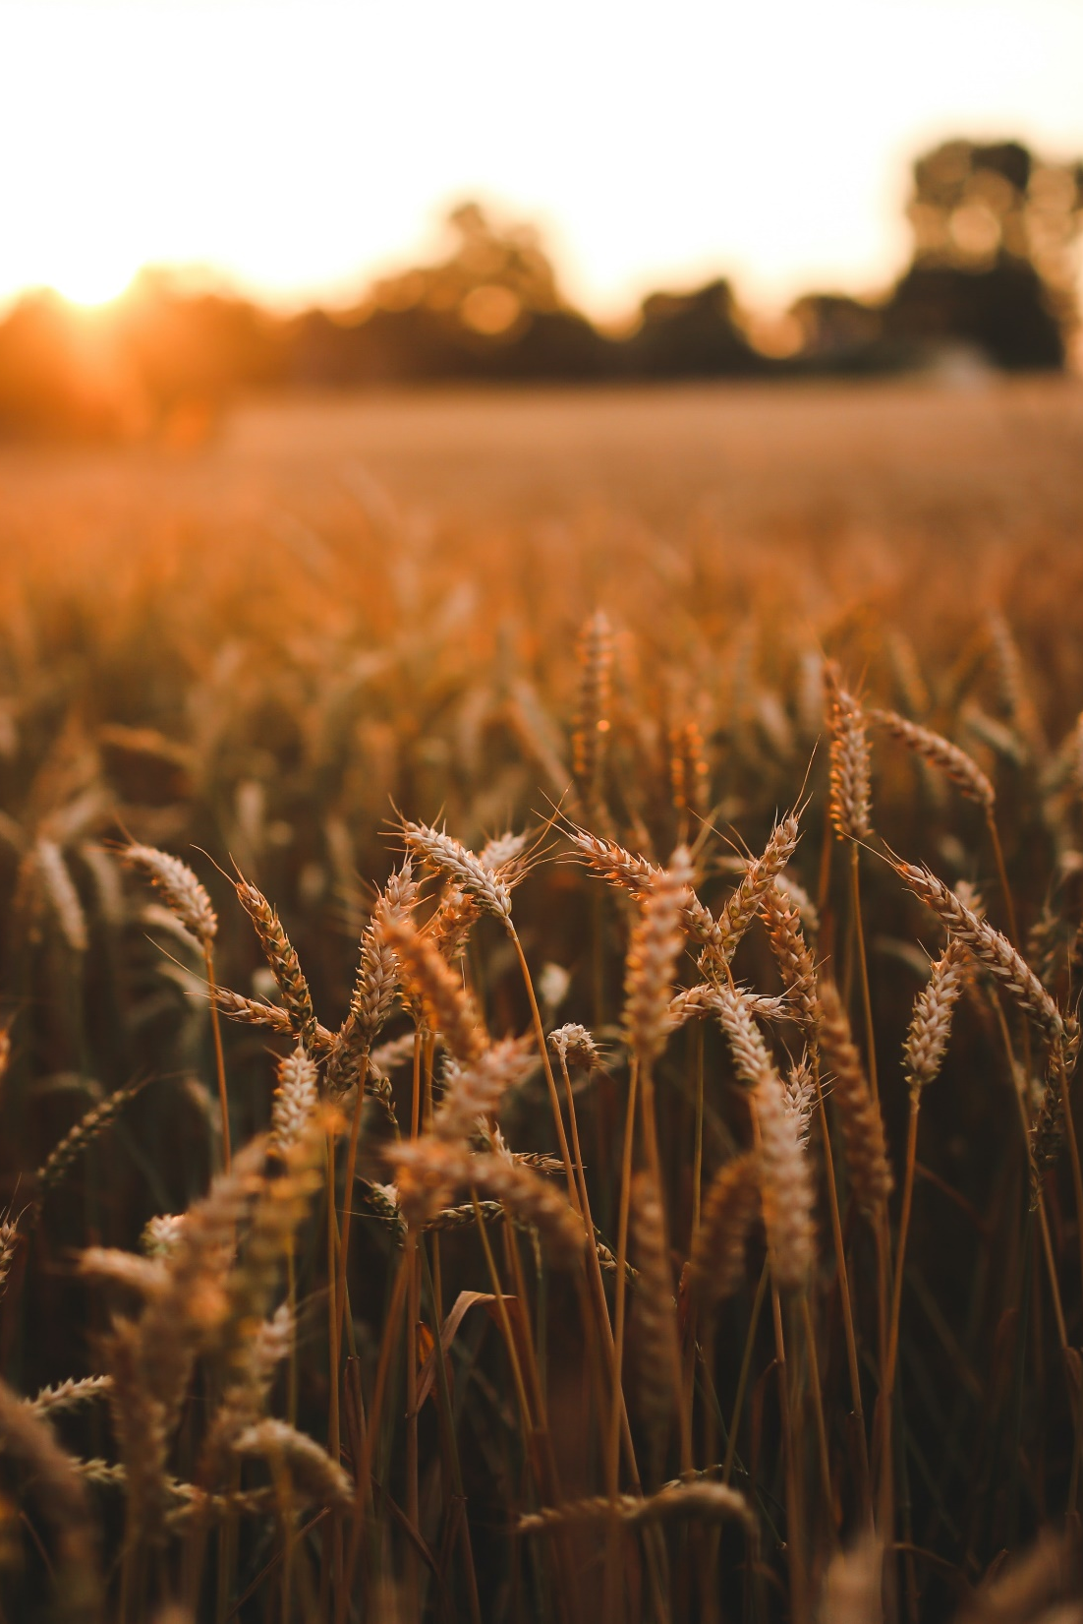

The most important crop in Sri Lanka
Cultivated area – 34%
Family farmers - 1.8 million
Total calories consumed by an average Sri Lankan - 45% [2]

Slide 5
“The government will have to import 800,000 to 1,000,000 MT of rice to meet the shortfall in the domestic supply, at a cost of USD 450 million, according to the URPA chief”.

Slide 6
Research Problem
Common issues Rice farmers face
Pests and Diseases
Weeds
Fertilizer misuse
Growth deficiency
Information sharing
Climate change
Security
Yield/profit prediction
Inventory management

Slide 7
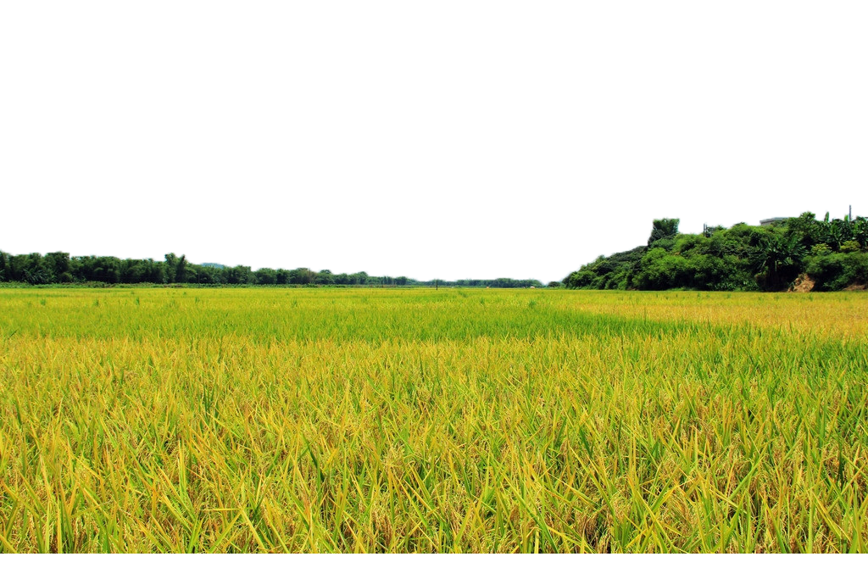
Main Objective
Aid struggling rice farmers by providing proper guidance for the most prevalent issues.

Slide 8
Sub objectives
Fertilizer Management
Identify Pests, Diseases then provide solutions
Identify Weeds and then provide solutions
Growth deficiency and then provide solutions

Slide 9
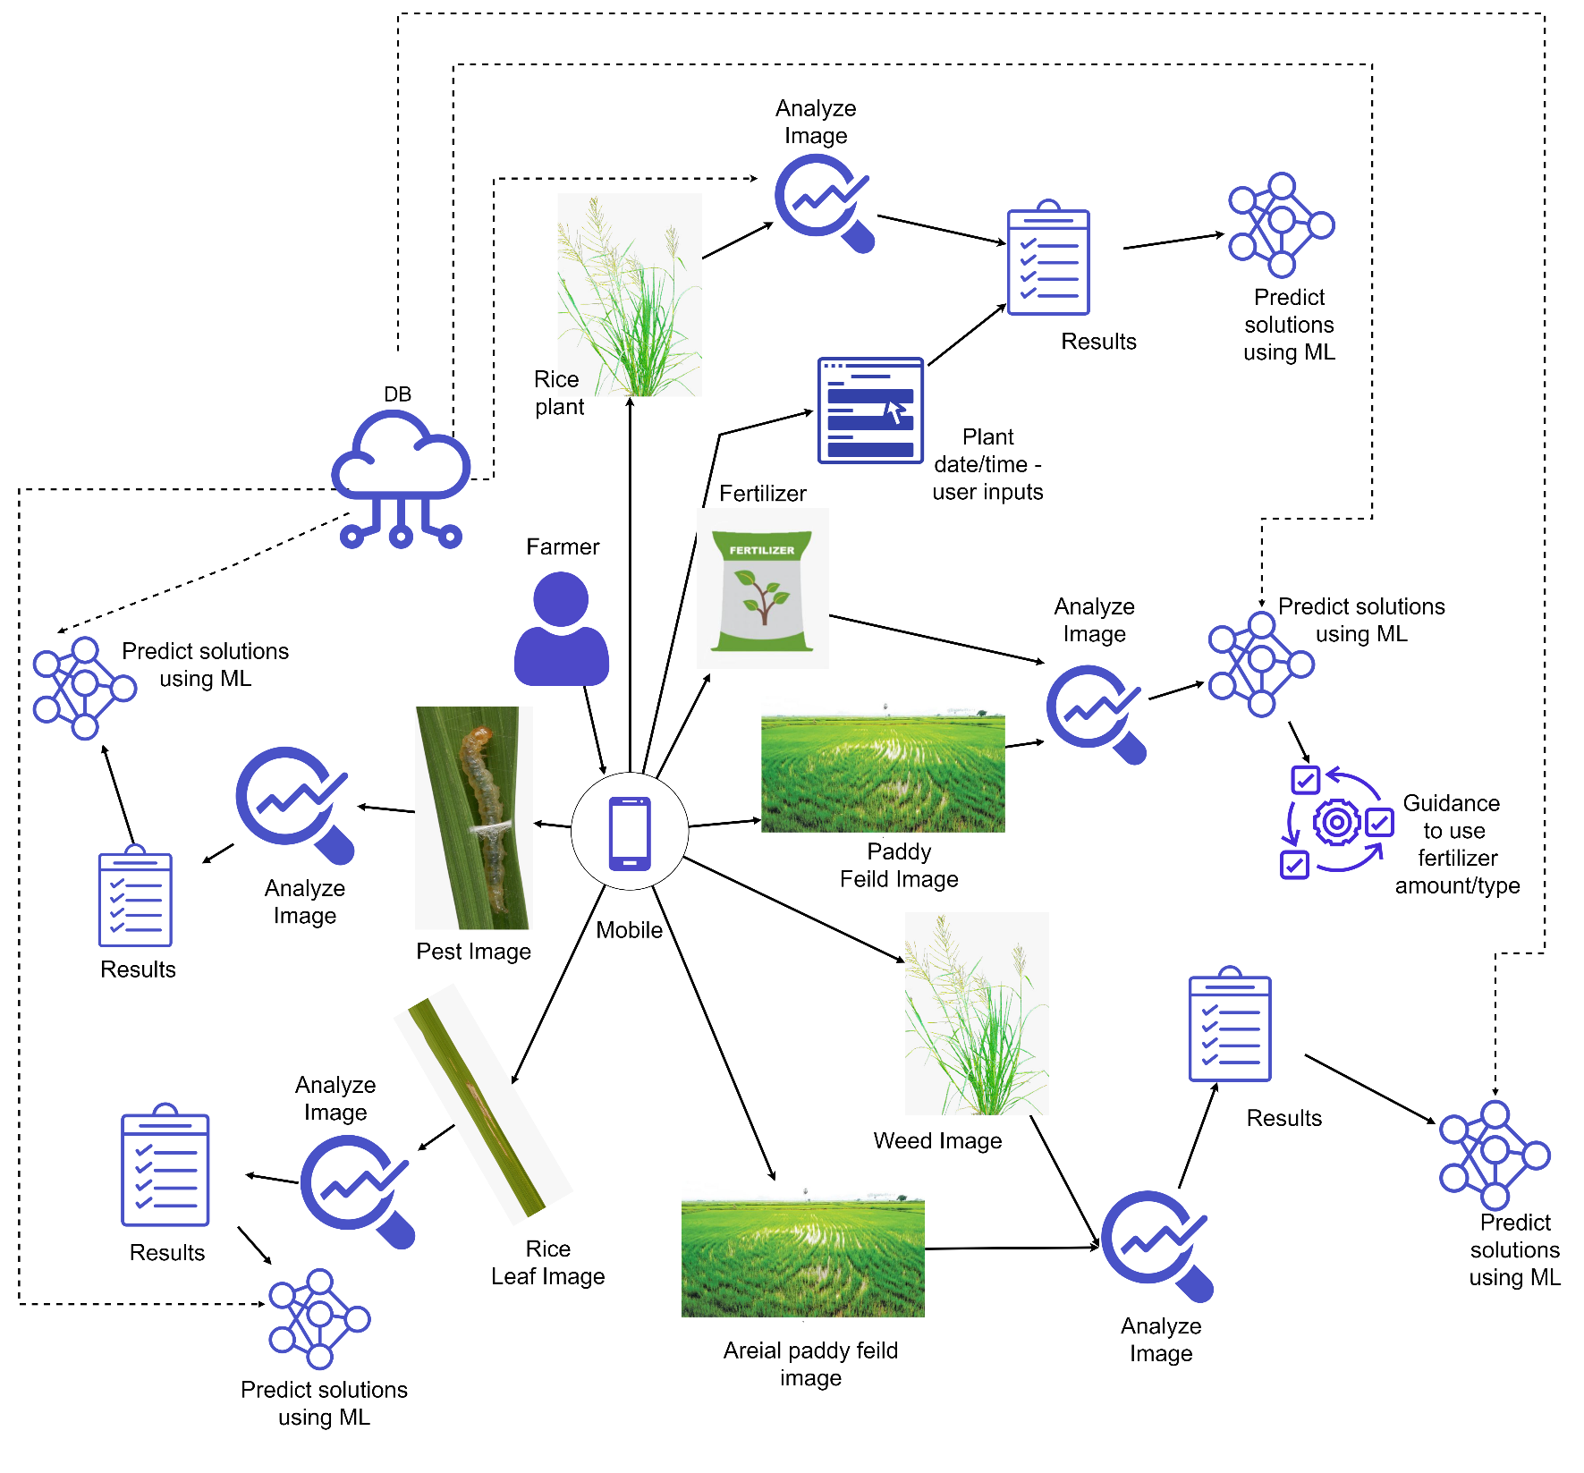
Overall System Diagram

Slide 10

IT19101620 | Salika Madhushanka W.J
Software Engineering
IT19101620 | Salika Madhushanka W.J | 2022-81

Slide 11
Research Question
How to find a proper dataset?
How to provide solutions for Pests and diseases?
How to detect pests?
How to detect rice diseases?

Slide 12
Specific and Sub Objectives
Specific Objectives
Identify of Rice diseases.
Identify of Rice pests.
Sub Objectives
Find pests and diseases data set for detection.
Detecting pests and diseases and their type through an image given to the mobile app.
Defining models for both identifications.
Configuring the model so that it can be used from the mobile app.
Providing solutions for pests and diseases.

Slide 13
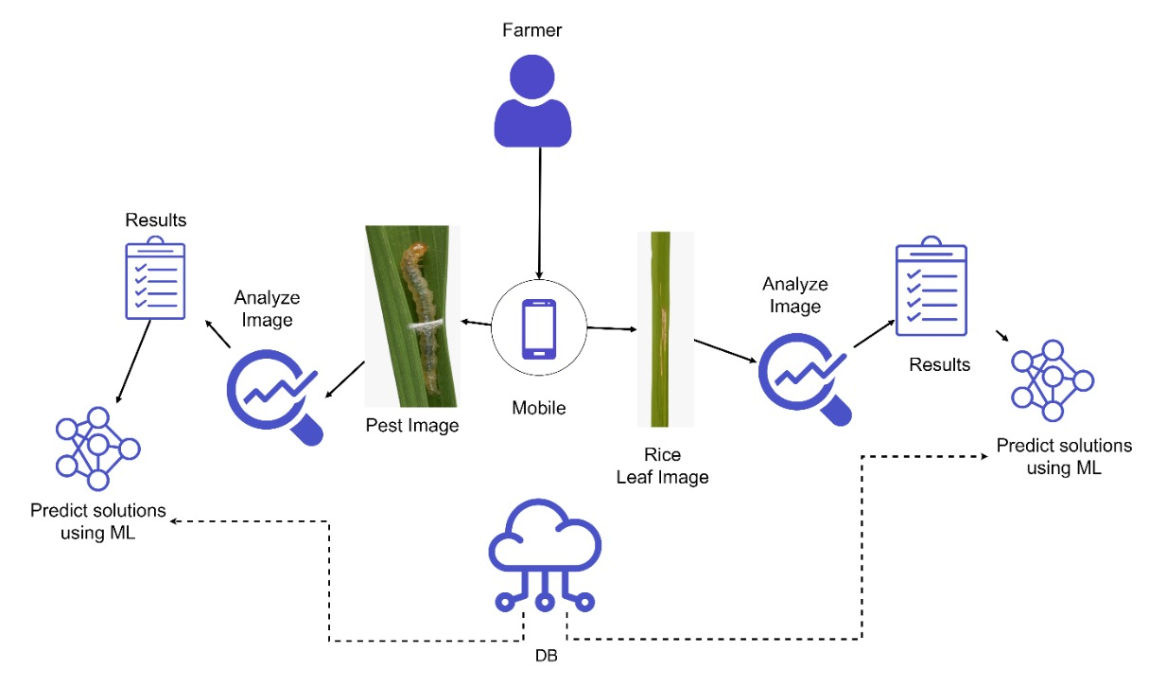
Methodology
System Overview Diagram

Slide 14
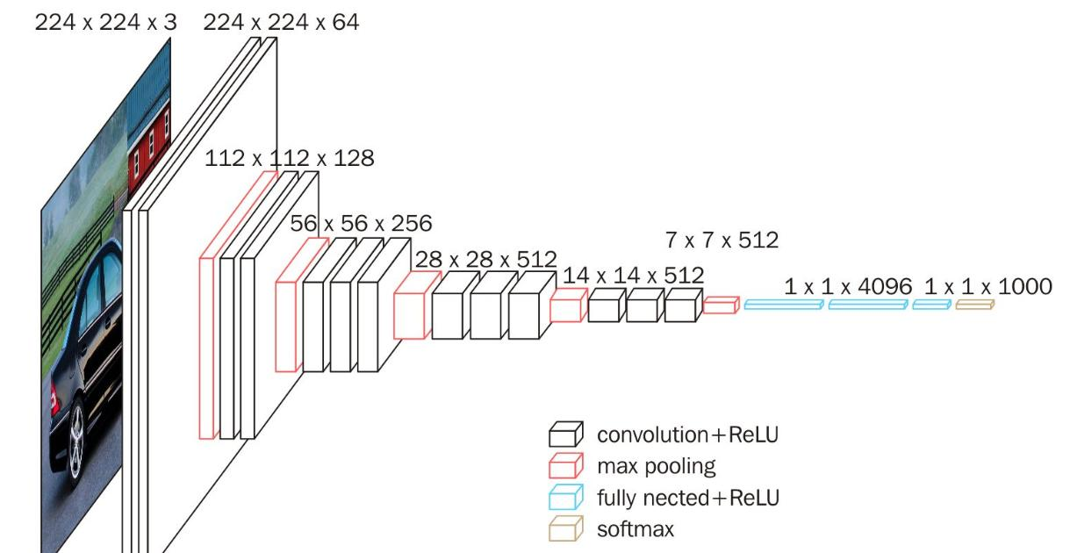


Methodology Cont...
Used technologies
Diseases Identification Model
CNN Architecture
Tools and Frameworks
Keras - Tensorflow
Pest measurement Model
AlexNet Architecture
IDE
Jupyter Notebook.

Slide 15
Model
What is CNN?
How I modify it?
Pre-processing
Hyperparameter tuning

Slide 16
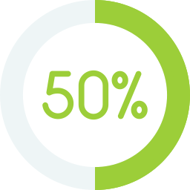
Current Progress
Collected pest and disease identification image datasets.
Optimized the image datasets.
Defined a model to identify diseases and pests.
Trained and optimized the previously mentioned model.

Slide 17
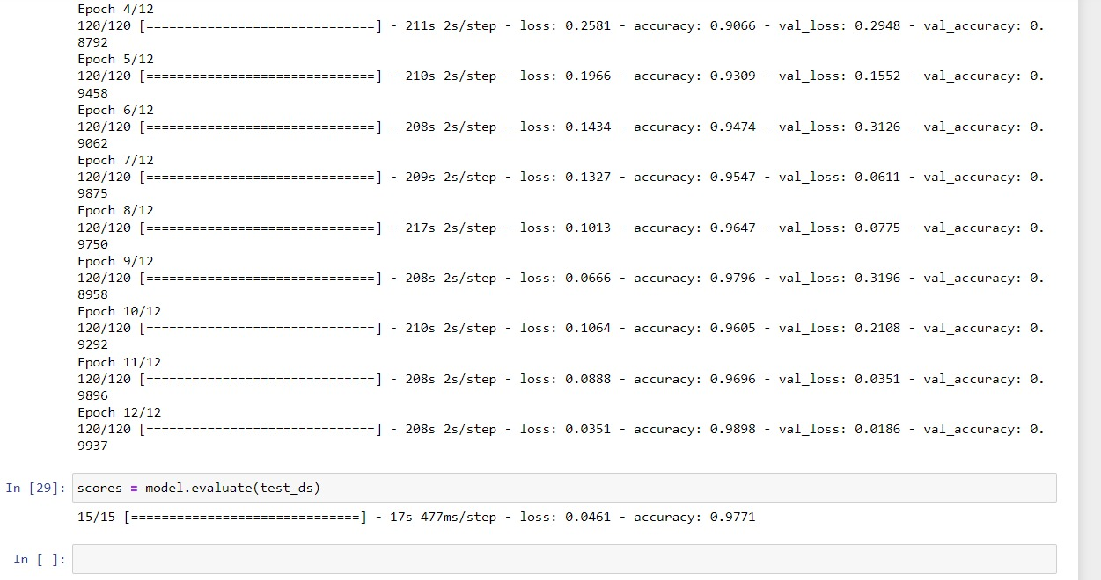
Evidences for the completion
Model accuracy

Slide 18
Evidences for the completion
Epoch | Accuracy | Loss
07 | 0.9547 | 0.1327
08 | 0.9647 | 0.1013
09 | 0.9796 | 0.0666
10 | 0.9685 | 0.1064
11 | 0.9696 | 0.0888
12 | 0.9898 | 0.0351
Model accuracy

Slide 19
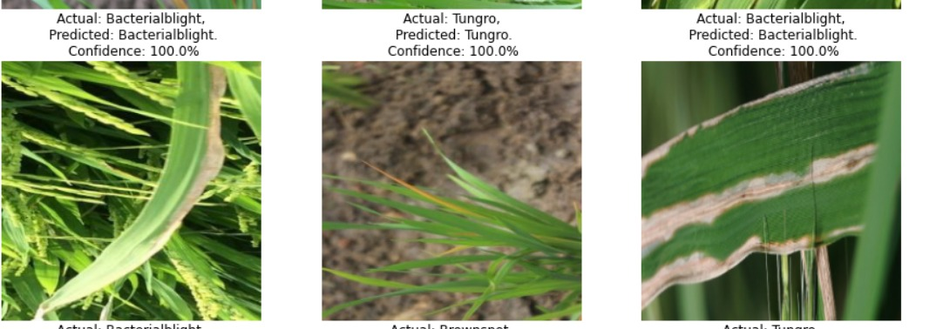
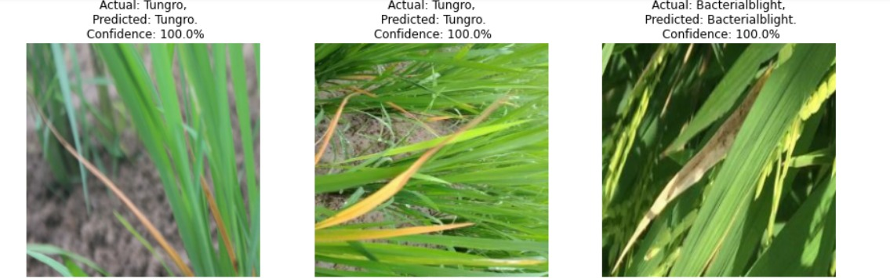
Evidences for the completion
Model accuracy

Slide 20
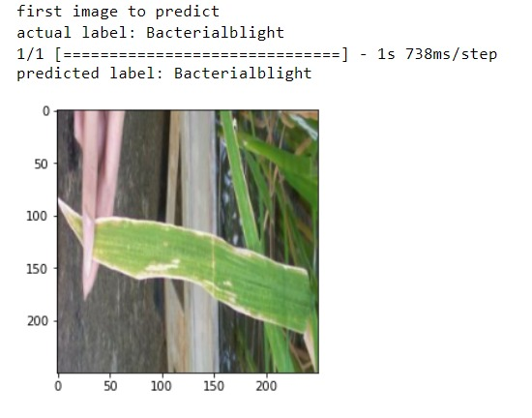
Evidences for the completion
Prediction

Slide 21
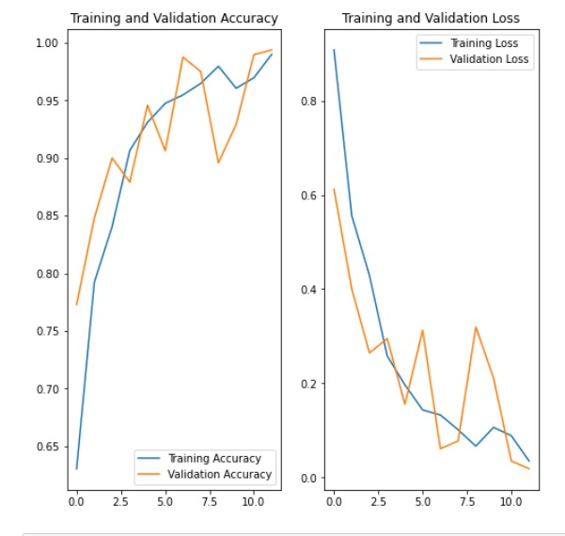
Evidences for the completion cont.…
Test accuracy chart

Slide 22
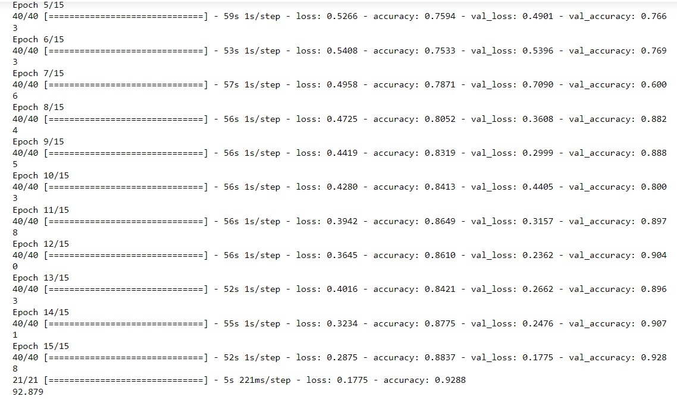
Evidences for the completion
Model accuracy

Slide 23
Evidences for the completion
Epoch | Accuracy | Loss
10 | 0.8413 | 0.4280
11 | 0.8649 | 0.3942
12 | 0.8610 | 0.3645
13 | 0.8421 | 0.4016
14 | 0.8775 | 0.3234
15 | 0.8837 | 0.2875
Model accuracy

Slide 24
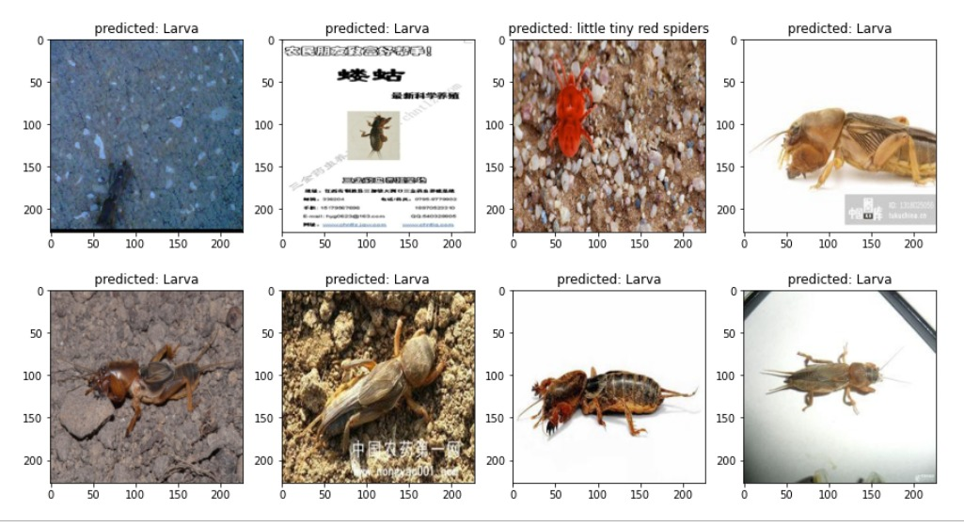
Evidences for the completion
Prediction

Slide 25
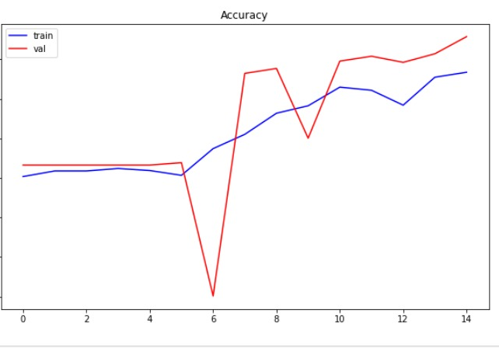
Evidences for the completion cont.…
Test accuracy chart

Slide 26
Completion of the project
Working Plan
90%
Providing solutions for the pests and diseases.
50%
Identify diseases and pests of rice plant
70%
Optimize pests and disease models further.

Slide 27

Completion of the project
Future works
Optimize both pests and diseases models.
How to best optimize the defined model?
How to integrate the models into the app?

Slide 28

IT19117256 | P.Y.D Jayasinghe
Software Engineering
IT19117256 | P.Y.D Jayasinghe | 2022-81

Slide 29
Research Question
How to find a proper dataset?
How to identify weed areas in paddy fields?
How to map those areas for the farmer to see?
How to identify weed types?
How to detect specific kinds of weeds?
How to provide solutions for weeds

Slide 30
Specific and Sub Objectives
Specific Objectives
Identify weed areas.
Identify weed type.
Sub Objectives
Find weed data set for mapping and detection.
Mapping weeds through aerial imagery given to the mobile app.
Detecting weeds and their type through an image given to the mobile app.
Defining models for both identification and mapping of weeds.
Configuring the model so that it can be used from the mobile app.
Providing solutions for weeds

Slide 31
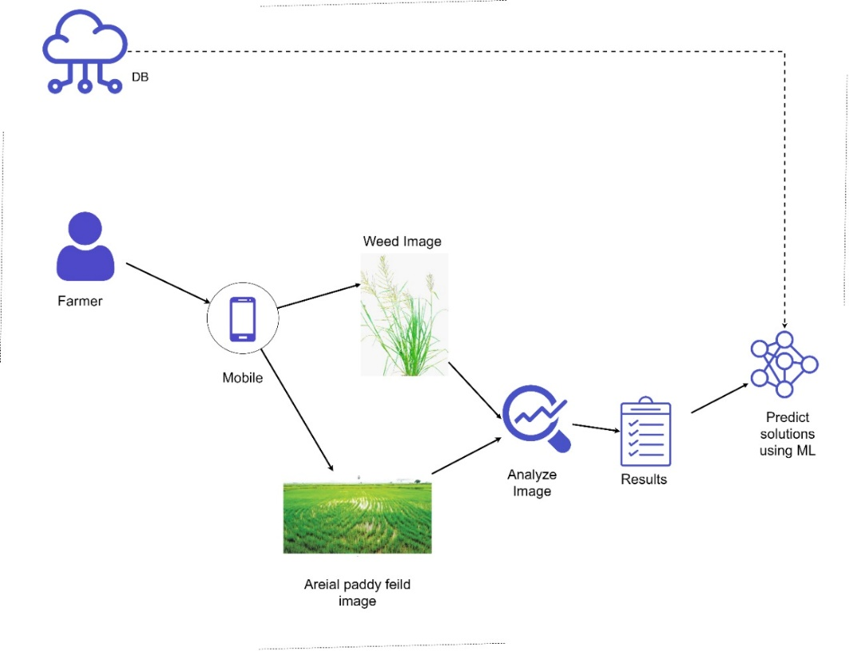
Methodology
System Overview Diagram

Slide 32

Methodology Cont...
Used technologies
Weed Identification Model
Resnet50 – CNN model
Semantic Segmentation Model
FCNN
IDE
Google Colab/ Jupyter Notebook.

Slide 33
Model
What is ResNet?
How I modify it?
Pre-processing
Hyperparameter tuning

Slide 34
Current Progress
Collected image datasets for weed types and weed mapping.
Optimized the image datasets.
Defined a model to identify weeds.
Trained and optimized the previously mentioned model.
Found a model to map weed images.

Slide 35
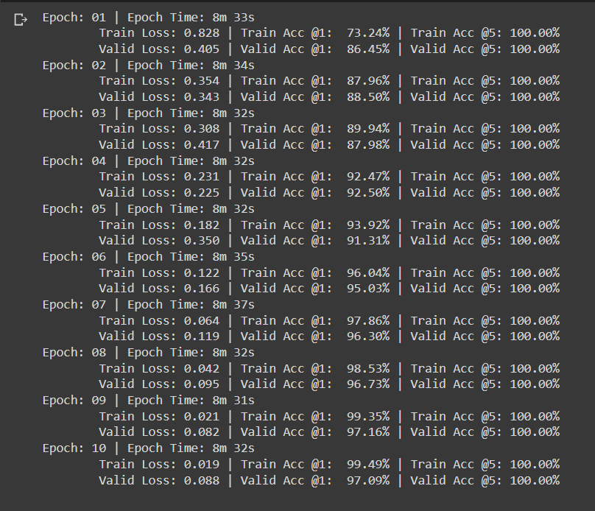
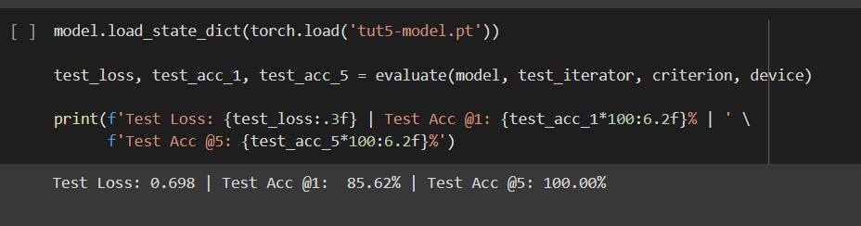
Evidences for the completion
Test accuracy
Training and Validation accuracy

Slide 36
Evidences for the completion
Epoch | Accuracy | Loss
05 | 93.92% | 0.182
06 | 96.04% | 0.122
07 | 97.86% | 0.064
08 | 99.53% | 0.042
09 | 99.35% | 0.021
10 | 99.49% | 0.019
Model accuracy

Slide 37
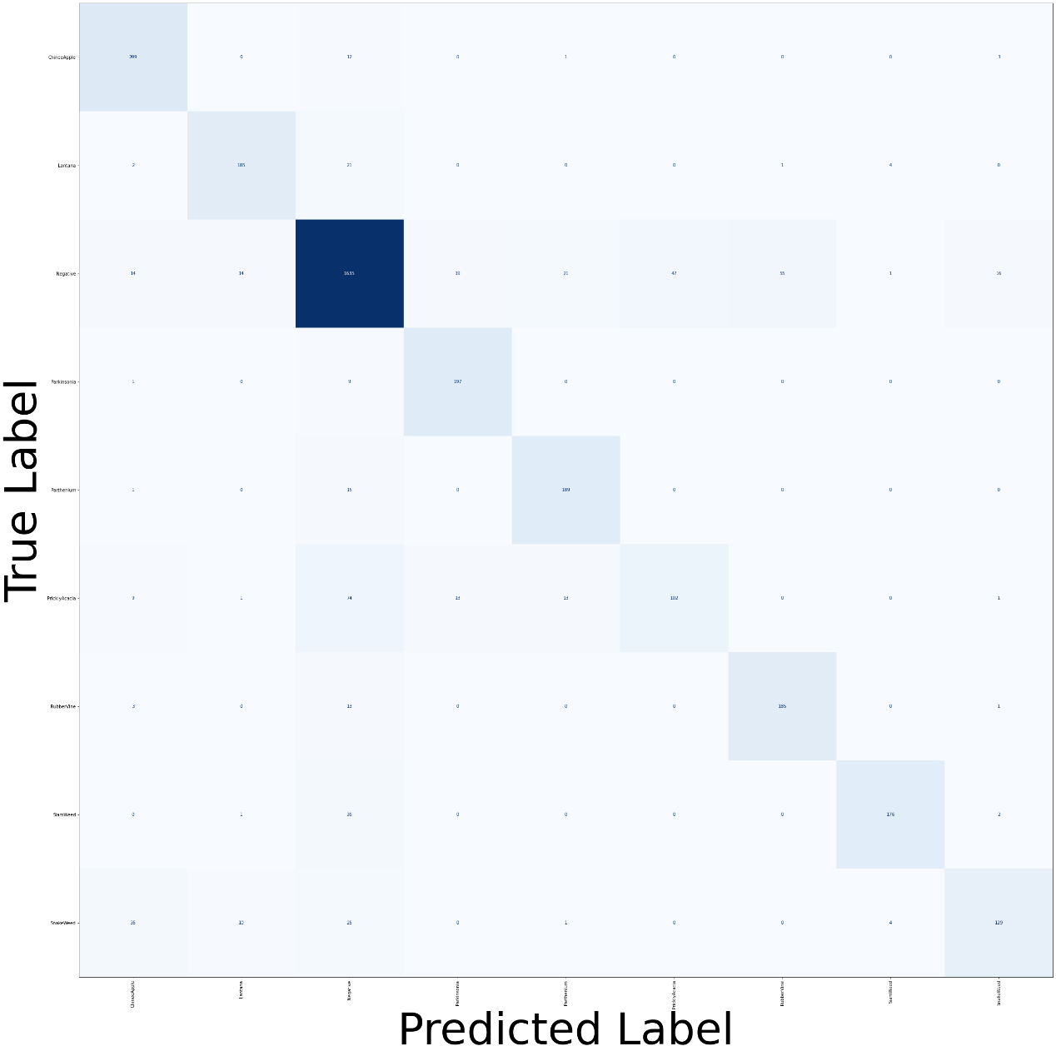
Evidences for the completion cont.…
Test data after prediction

Slide 38
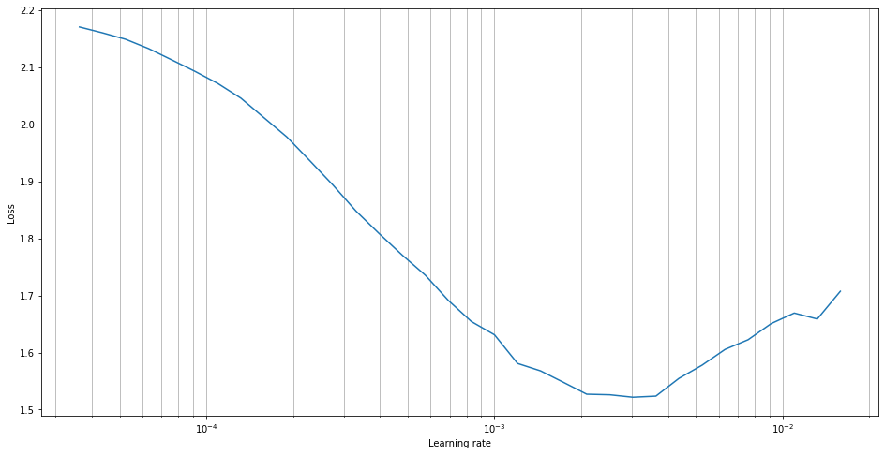
Evidences for the completion cont.…

Slide 39
Evidences for the completion
 | ChineeApple | Lantana | Negative | Parkinsonia | Parthenium | PricklyAcacia | RubberVine | SiamWeed | SnakeWeed
ChineeApple | 209 | 0 | 12 | 0 | 1 | 0 | 0 | 0 | 3
Lantana | 2 | 185 | 21 | 0 | 0 | 0 | 1 | 4 | 0
Negative | 14 | 14 | 1635 | 19 | 21 | 47 | 55 | 1 | 16
Parkinsonia | 1 | 0 | 9 | 197 | 0 | 0 | 0 | 0 | 0
Parthenium | 1 | 0 | 15 | 0 | 189 | 0 | 0 | 0 | 0
PricklyAcacia | 9 | 1 | 74 | 13 | 13 | 102 | 0 | 0 | 1
RubberVine | 3 | 0 | 13 | 0 | 0 | 0 | 185 | 0 | 1
SiamWeed | 0 | 1 | 36 | 0 | 0 | 0 | 0 | 176 | 2
SnakeWeed | 35 | 10 | 25 | 0 | 1 | 0 | 0 | 4 | 129
Training and Validation accuracy

Slide 40
Completion of the project
Working Plan
90%
Provide solutions for weeds
80%
Map weeds using aerial imagery
50%
Identify weeds and their type
60%
Define a weed mapping model

Slide 41
Completion of the project
Future works
Defining the model for weed mapping.
How to best optimize the defined model?
How to integrate the models into the app?

Slide 42

IT19129372 | h.h.w.m.Binuka Sihan paranagamA
Software Engineering
IT19129372 | H.H.W.M.Binuka Sihan Paranagama | 2022-81

Slide 43
Research Question
How to find a proper dataset?
How to provide guidance on usage of fertilizers?
How to measure the area of the paddy field?
How to detect the fertilizer type?

Slide 44
Specific and Sub Objectives
Specific Objectives
Identify of Fertilizer type.
Measure the paddy area.
Provide guidance on how to use fertilizers.
Sub Objectives
Find fertilizer data set for detection.
Detecting fertilizers type then paddy area using imagery and GPS via a mobile app.
Defining models for both identification and area measurement.
Configuring the model so that it can be used from the mobile app.
Providing guidance on how to fertilize their paddy fields.

Slide 45
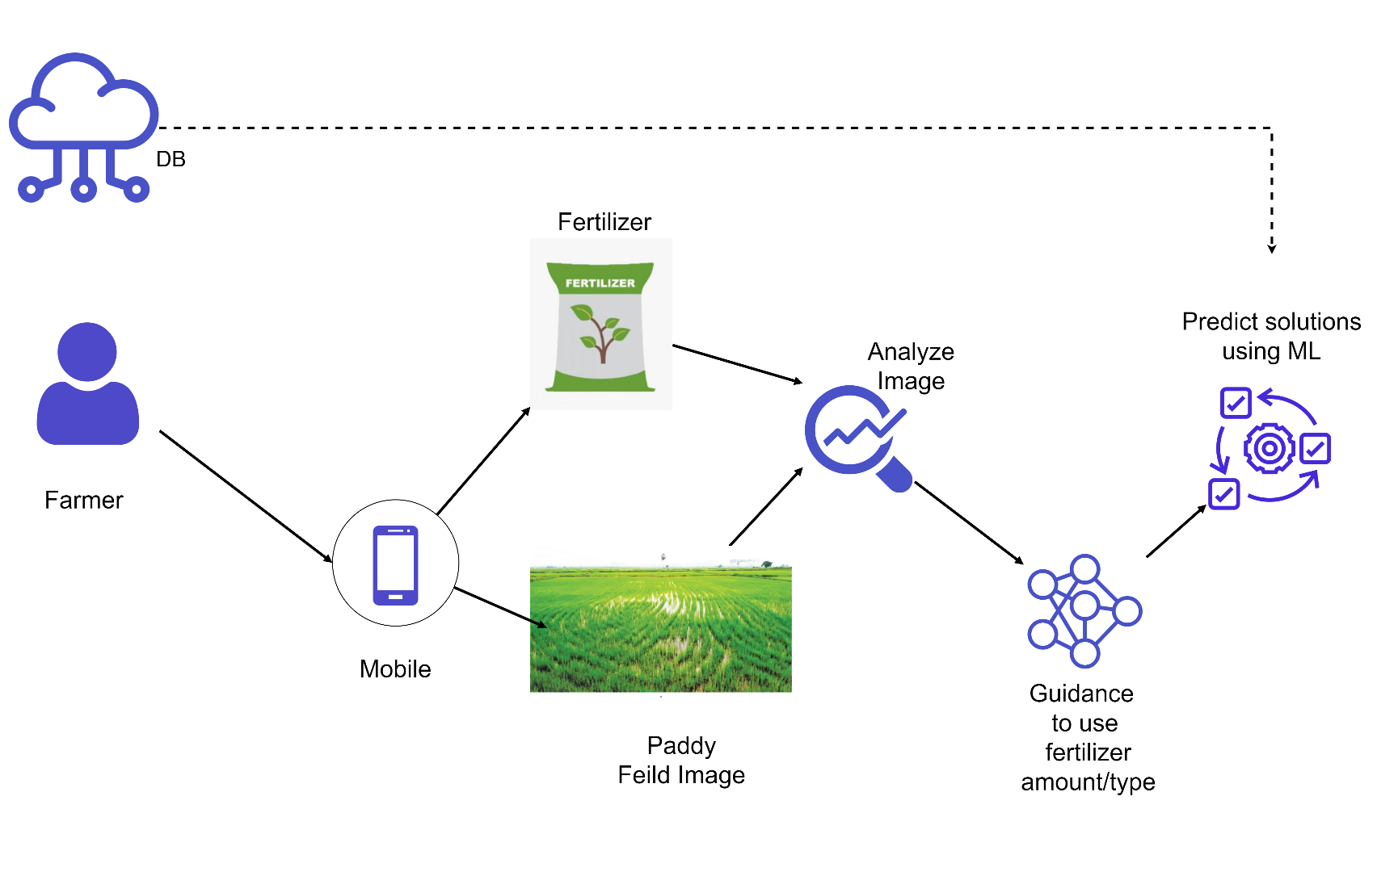
Methodology
System Overview Diagram

Slide 46

Methodology Cont...
Used technologies
Fertilizers Identification Model
CNN model
Tools and Frameworks
Keras - Tensorflow
Area measurement
GPS
IDE
Jupyter Notebook.
Android Studio

Slide 47
Model
Model
How I modify it?
Pre-processing
Hyperparameter tuning

Slide 48
Current Progress
Collected fertilizer identification image datasets.
Optimized the image datasets.
Defined a model to identify fertilizer type.
Trained and optimized the previously mentioned model.
Developed a Mobile application to track the location.
Use the application to calculate area

Slide 49
Evidences for the completion

Slide 50
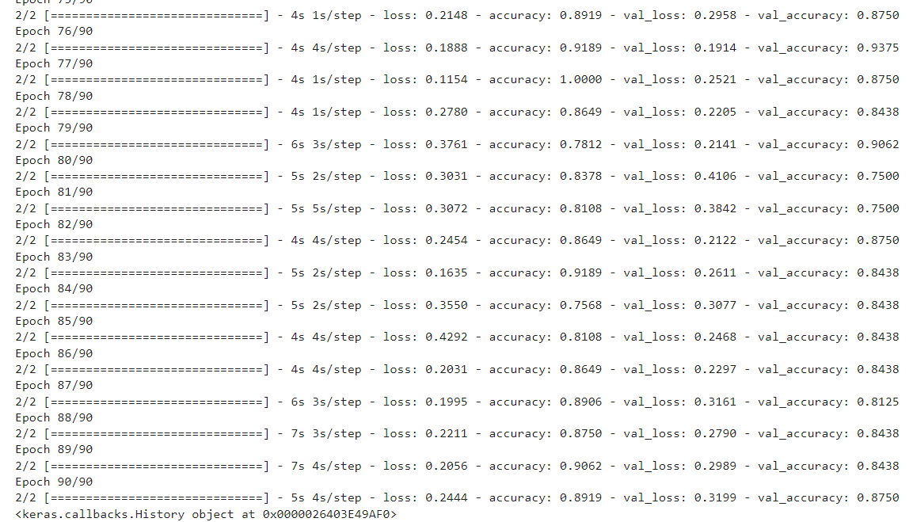
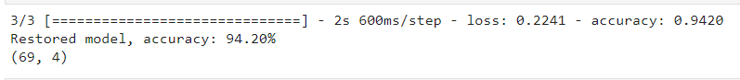
Fertilizer prediction model
Model accuracy

Slide 51
Evidences for the completion
Epoch | Accuracy | Loss
85 | 0.8108 | 0.4292
86 | 0.8649 | 0.2031
87 | 0.8906 | 0.1995
88 | 0.8750 | 0.2211
89 | 0.9062 | 0.2056
90 | 0.8919 | 0.2444
Model accuracy

Slide 52
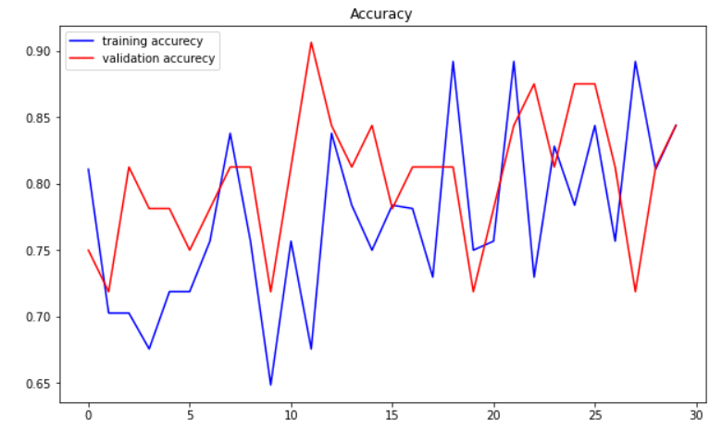
Fertilizer prediction model
Train accuracy chart

Slide 53
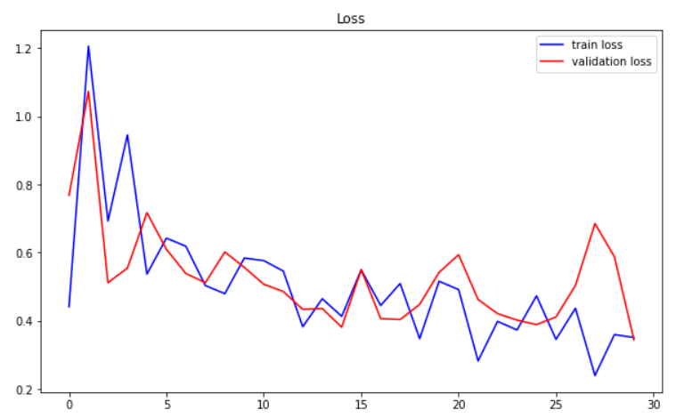
Fertilizer prediction model
Test accuracy chart

Slide 54
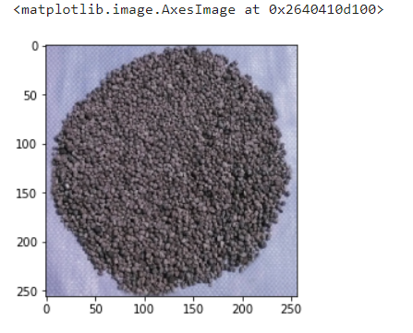
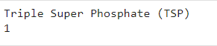
Fertilizer prediction model
Prediction

Slide 55
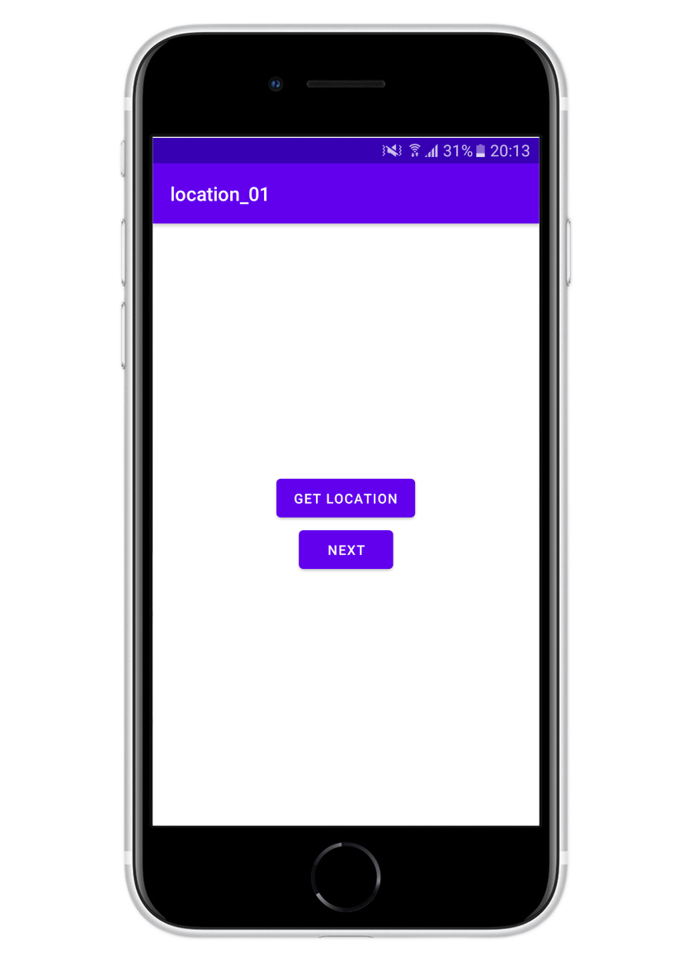
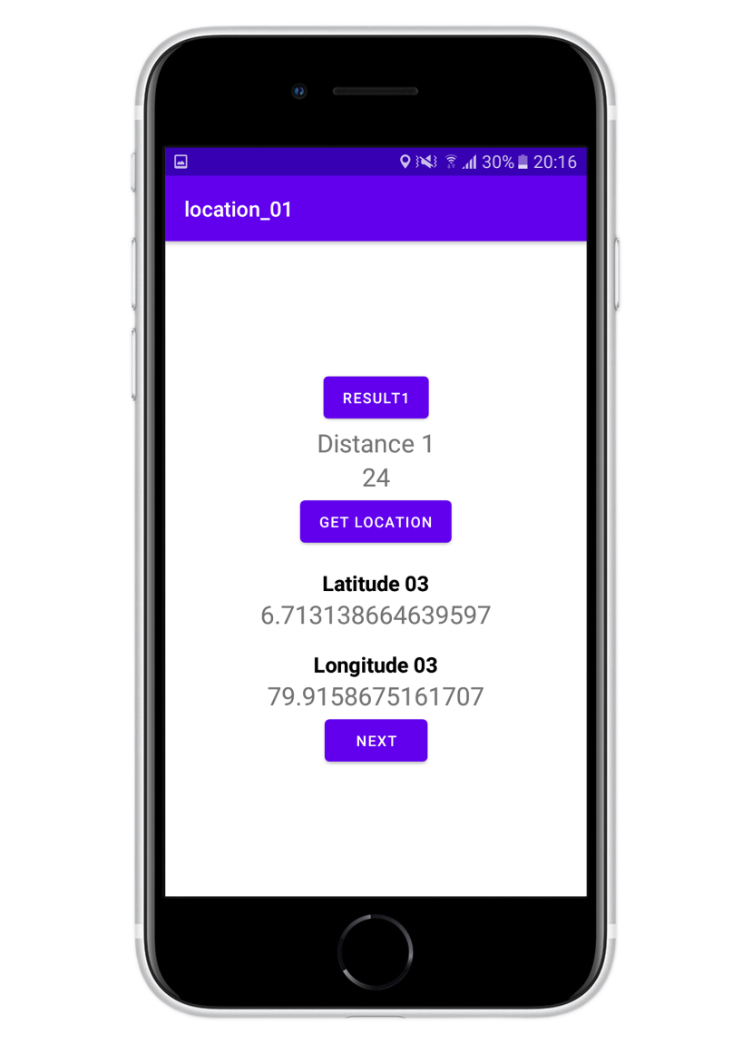
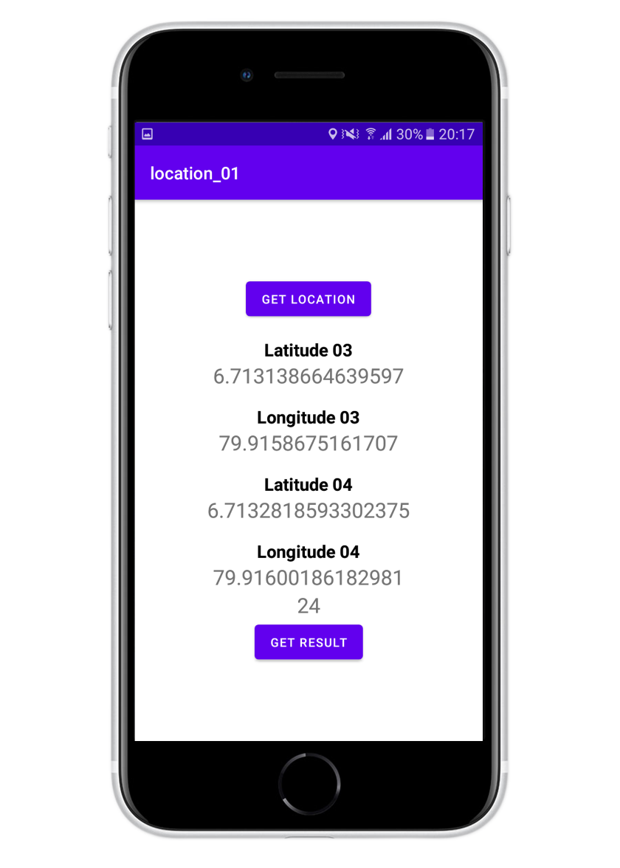
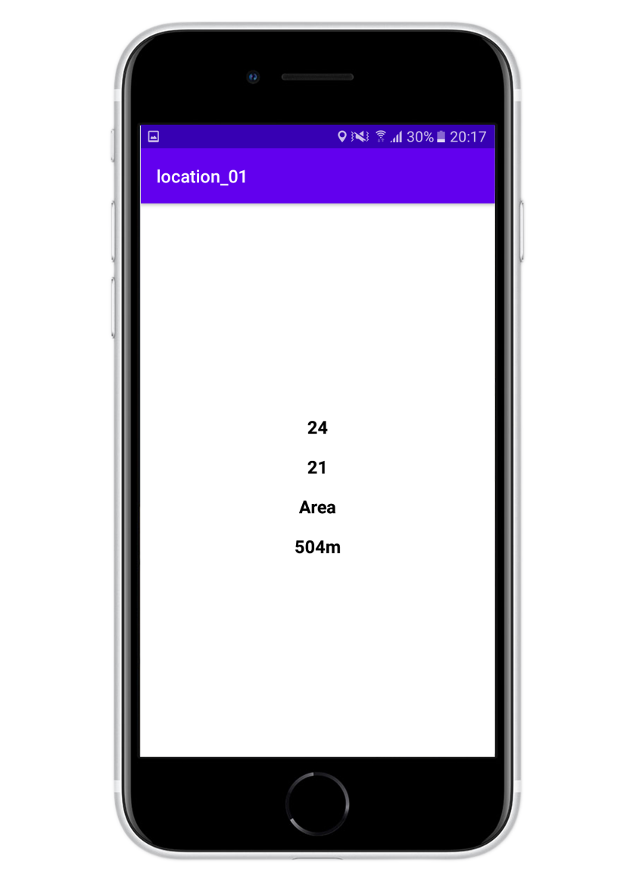
Mobile Application for the Area Calculation
Area

Slide 56
Completion of the project
Working Plan
90%
Providing guidance for the on properly use of fertilizers.
80%
Map both models.
50%
Identify fertilizers type and calculate paddy area
60%
Define a paddy area measuring model

Slide 57
Completion of the project
Future works
Defining the model for paddy area measurement.
How to best optimize the defined model?
How to integrate the models into the app?

Slide 58

IT19240152 | K.M.Umesh Ranthilina
Software Engineering
IT19240152 | K.M.Umesh Ranthilina | 2022-81

Slide 59
Research Question
How to find a proper dataset?
How to identify the growth using the height?
How to provide solutions for deficiencies in growth?
How to measure height of a plant?
How to detect rice plants from other plants?

Slide 60
Specific and Sub Objectives
Specific Objectives
Identify of Rice plant.
Identify growth and deficiency.
Sub Objectives
Find rice data set for detection.
Detecting rice plants using image to figure out whether it is a rice plant or not through a mobile app.
Defining models for both identification and height measurement.
Configuring the model so that it can be used from the mobile app.
Providing solutions for the deficiency.

Slide 61
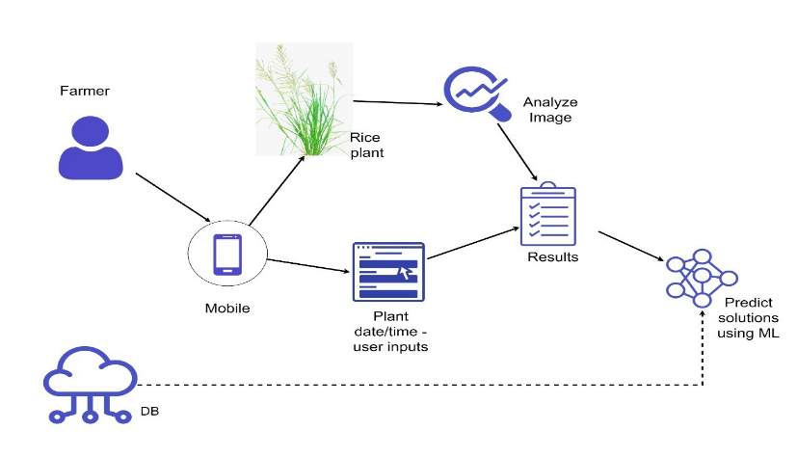
Methodology
System Overview Diagram

Slide 62

Methodology Cont...
Used technologies
Rice Identification Model
AlexNet – CNN model
Height measurement Model
Python - openCV
IDE
Jupyter Notebook.

Slide 63
Model
What is AlexNet?
How I modify it?
Pre-processing
Hyperparameter tuning

Slide 64
Current Progress
Collected height measurement and rice identification image datasets.
Optimized the image datasets.
Defined a model to identify rice.
Trained and optimized the previously mentioned model.

Slide 65
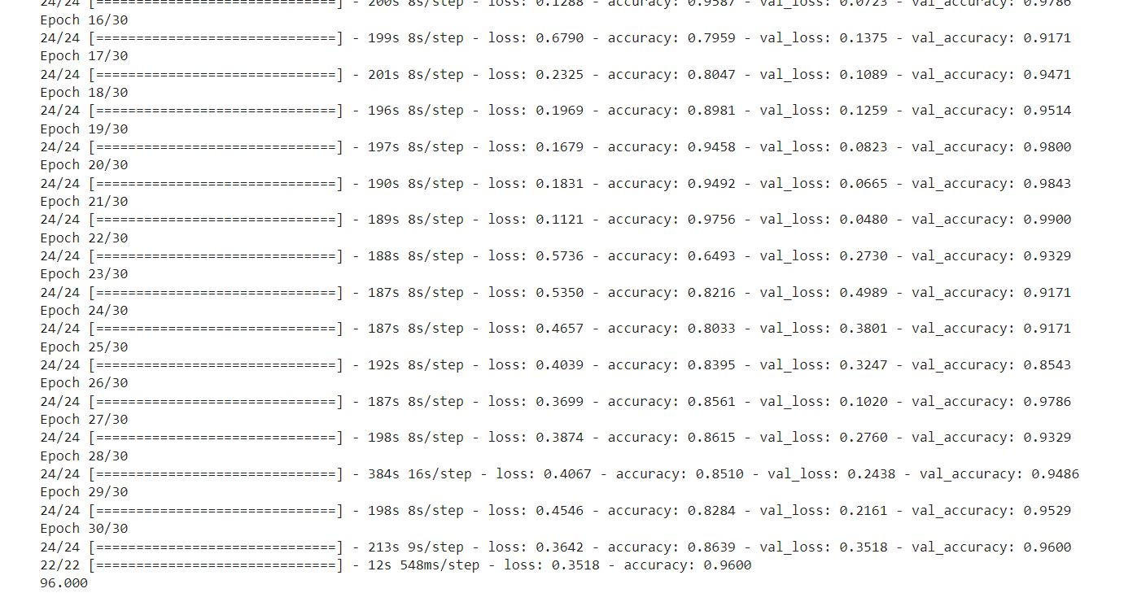
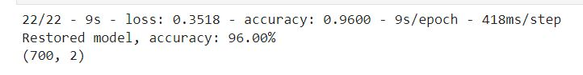
Evidences for the completion
Model accuracy

Slide 66
Evidences for the completion
Epoch | Accuracy | Loss
25 | 0.8395 | 0.4039
26 | 0.8561 | 0.3699
27 | 0.8615 | 0.3874
28 | 0.8510 | 0.4067
29 | 0.8264 | 0.4564
30 | 0.8639 | 0.3642
Model accuracy

Slide 67
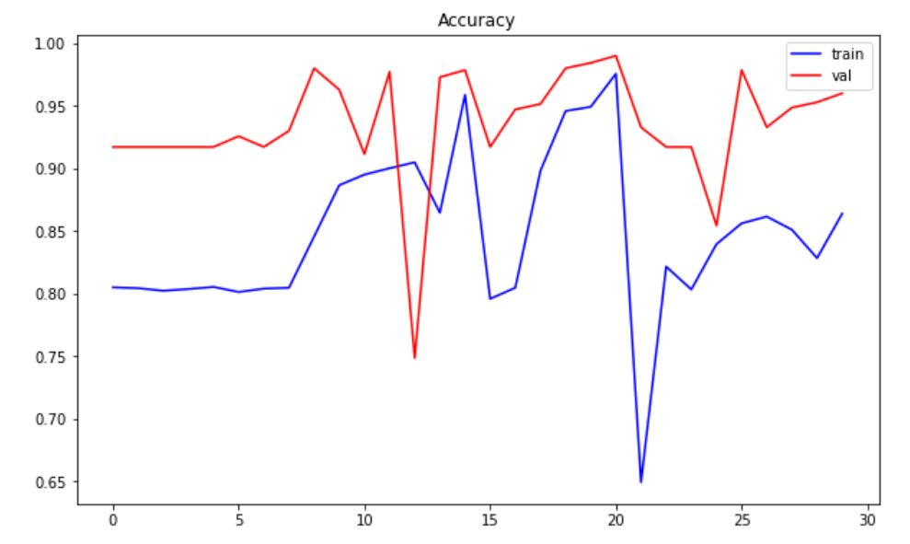
Evidences for the completion cont.…
Test accuracy chart

Slide 68
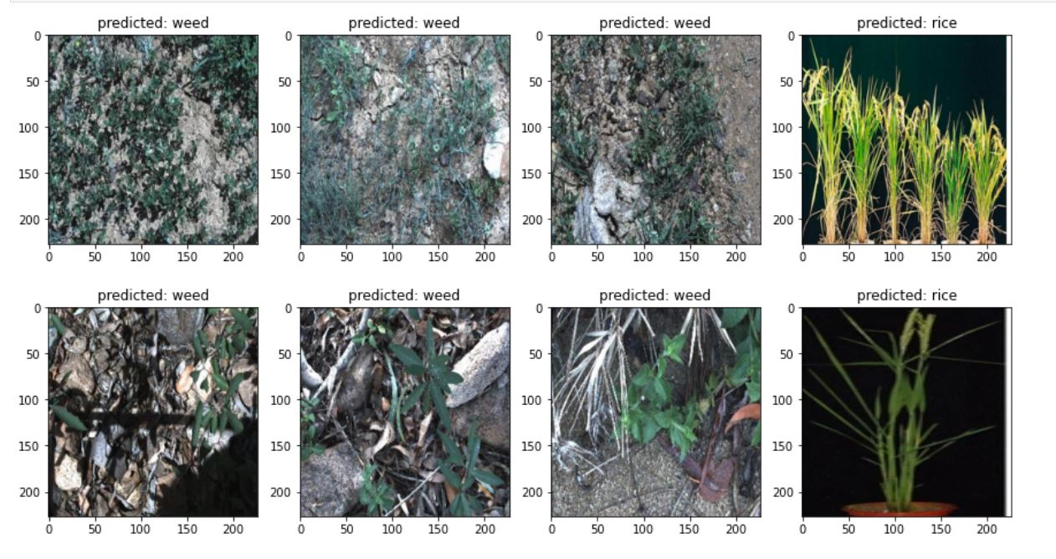
Evidences for the completion
Prediction

Slide 69
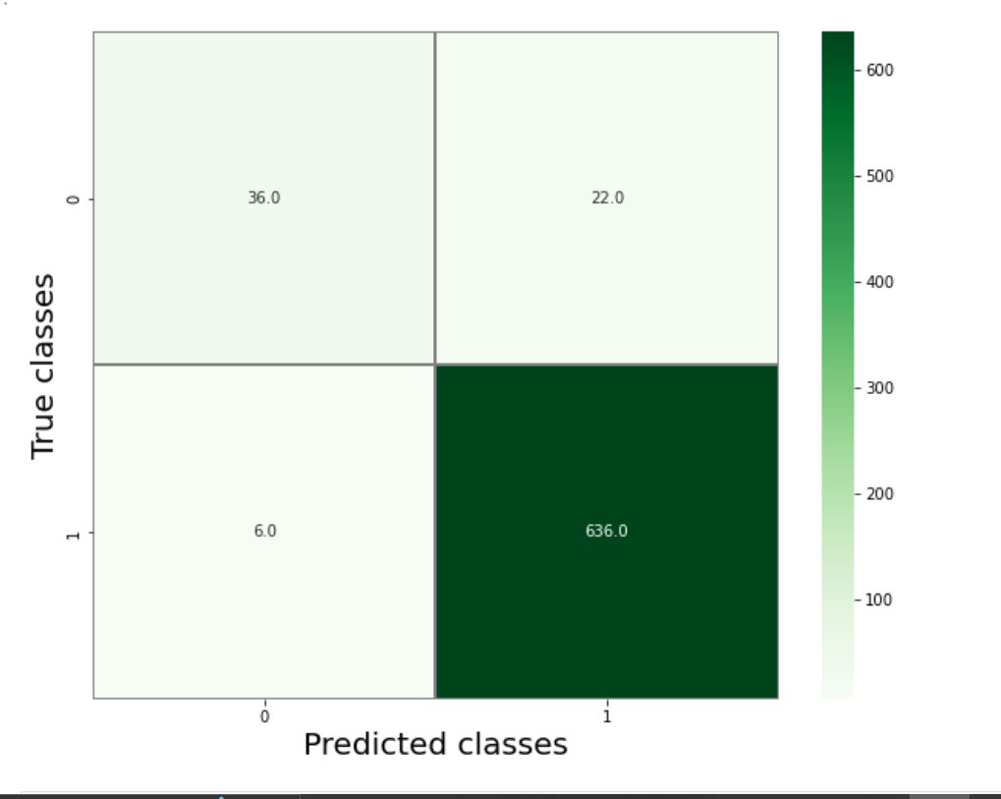
Evidences for the completion cont.…
Prediction accuracy chart

Slide 70
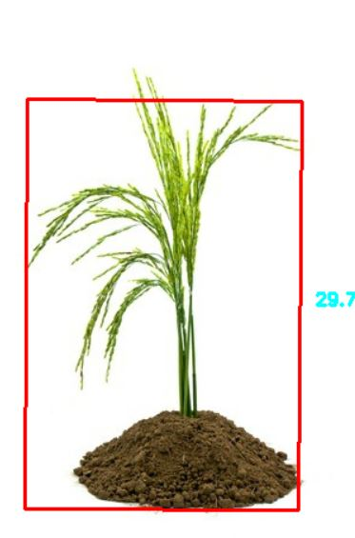
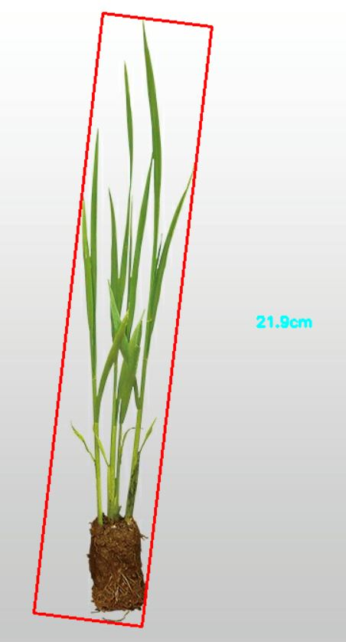
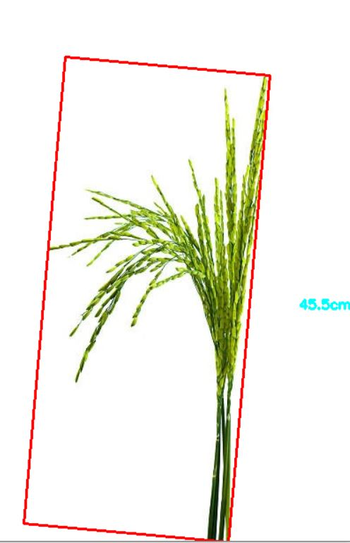
Evidences for the completion cont.…
Height measurement

Slide 71
Completion of the project
Working Plan
90%
Providing solutions for the deficiency.
80%
Find out deficiency or growth
50%
Identify rice plants
60%
Optimize the height measuring model

Slide 72
Completion of the project
Future works
How to best optimize the defined model?
How to integrate the models into the app?

Slide 73
THANK YOU

